Slide 1

Concepts for Healthcare Information Sharing
Context and Viewpoints

Slide 2
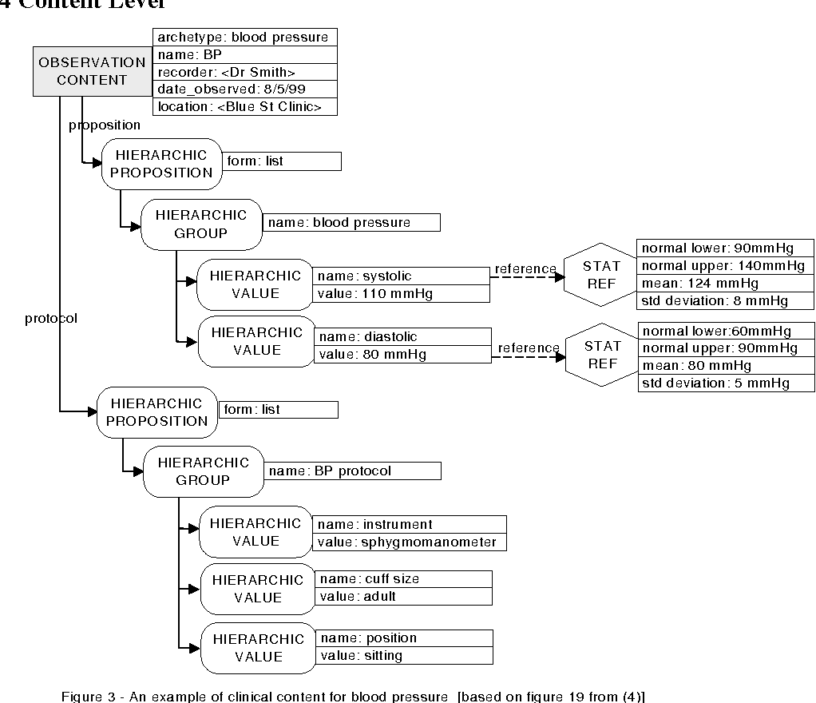
Data & Message models are great, but
Why data models are great
Clinical data models provide the information needed for a particular purpose, community, process, technology, application, or situation
The data is in context of and limited to this purpose in terms appropriate for that context
Terminology is specific to the purpose
It is clear how to implement an application using the data
The problem is
It is not appropriate for a different particular purpose, community, process, technology, application, or situation
Each will use a different data model, terminology, structure and/or technology
You can’t easily integrate or reuse data
So, what do we (mostly) do now
Manual point-point translations
Anti-agile, expensive, slow to develop, costly

Slide 3
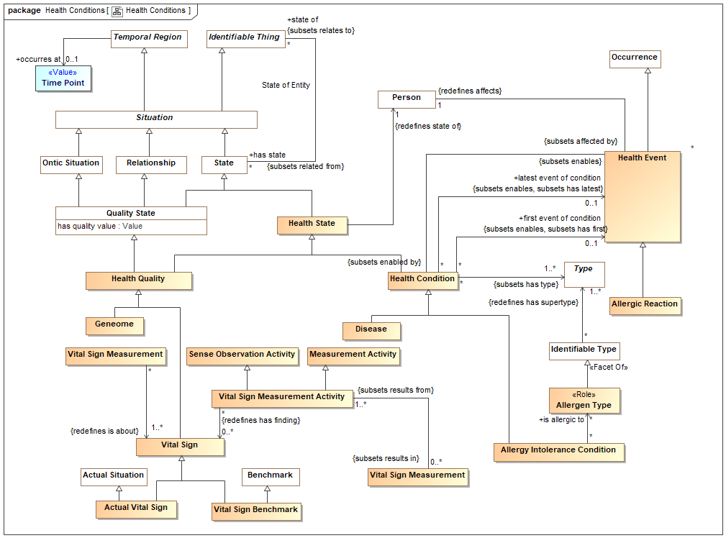
Semantic / ontology models are great, but
Why semantic models are great
Clinical concepts are grounded in their fundamental meaning
Concepts build on other concepts
Concepts span across purpose, community, process, technology, application, and situation
The problem is
The concepts are not contextualized for the purpose, community, process, technology, application, and situation
The models, by necessity, contain abstractions and general terminology not needed for a specific purpose
Concepts are loosely connected to how we keep our records
So, stakeholders don’t resonate with the semantic models
The general structures may not be appropriate for implementation.
We need both; The semantic and data models

Slide 4


The “real world” and records of it get conflated
Health Record
Vital sign Observation
Patient: John Snow
Time: 10:30am 3/21/2010
Taken By: Sue Miller
Topic: Body Temperature
Value: 101.5
Unit: DF
…
Related but not the same thing
At 10:30AM 3/21/2021 John’s body temperature was 101.5 degrees Fahrenheit
But you can’t understand the data without the real-world concept and you can’t communicate the concept without data

Slide 5

What we have failed, as an industry, to do is “connect the dots” between real-world concepts and purpose-specific data
?
We don’t understand the Context

Slide 6
a viewpoint is a separate model, a view of concepts in-context of the stakeholder’s purpose
Stakeholder’s context
Stakeholder’s
Viewpoint
Contextual view of
Data for
Technical Representation

Slide 7

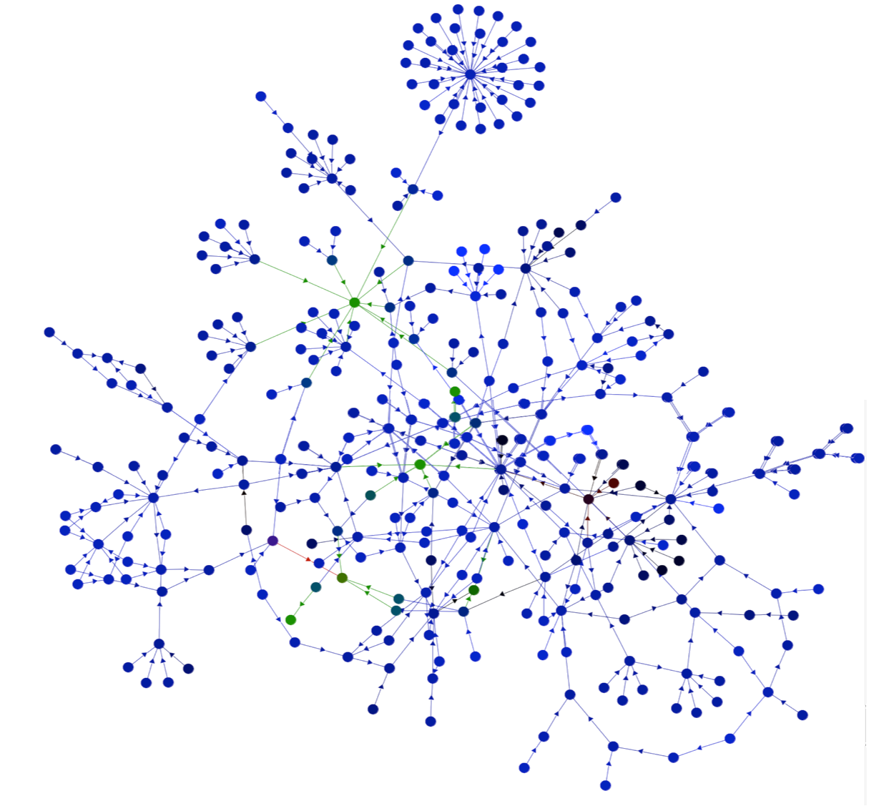

Our Proposition
Clinical
Viewpoint
There are many viewpoints representing many context
The implicit can be made explicit
The concepts that underly healthcare can be formalized, viewpoint terms and concepts related to general terms and concepts
We can bind the viewpoint specific vocabulary and situational data elements to these concepts
Resulting in
The situation specific vocabulary and data being precisely defined and expressible in natural language
increasing understanding and reducing risk
That the data connections among and between HIT, guidelines, and clinicians caring for patients can be automated
Reducing time, cost, and risk of integration
Guideline
Viewpoint
Concepts
HIT Viewpoint
Viewpoint
Relationships

Slide 8
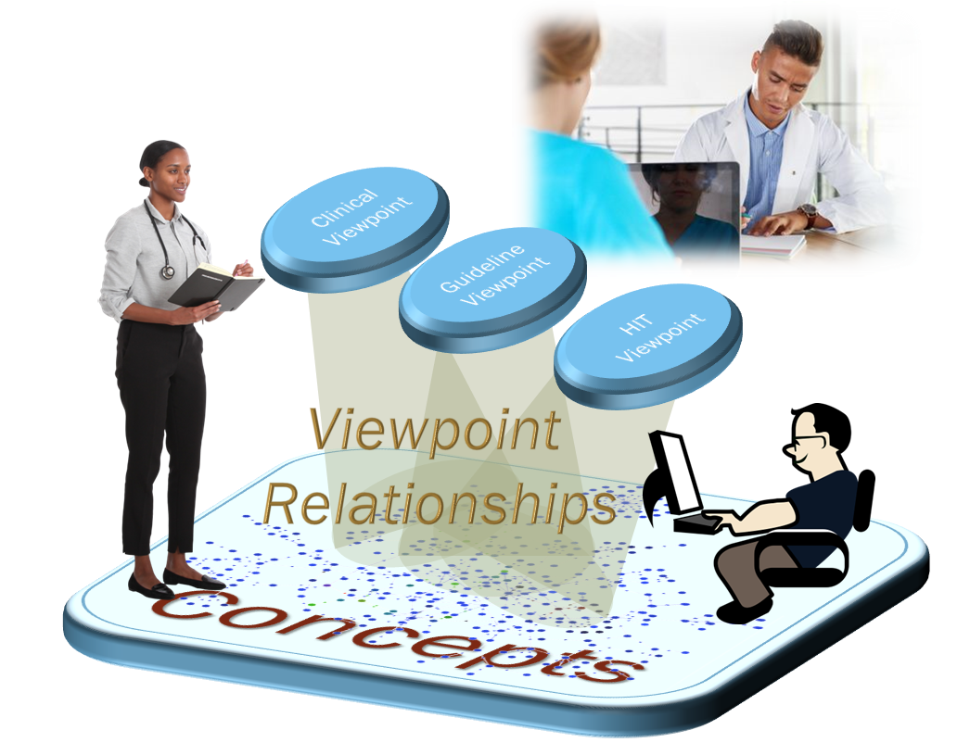
What is in the viewpoint model?
Limiting concepts relevant to the context
I just need the vital signs right now
Using the terminology of the stakeholder
Let's just call blood pressure “BP”
Qualifying concept as needed in the context
By BP I mean Arterial blood pressure at rest sampled twice over the last 15 minutes
“Flattening” uninteresting relationships or abstractions
Directly related to the current visit

Slide 9
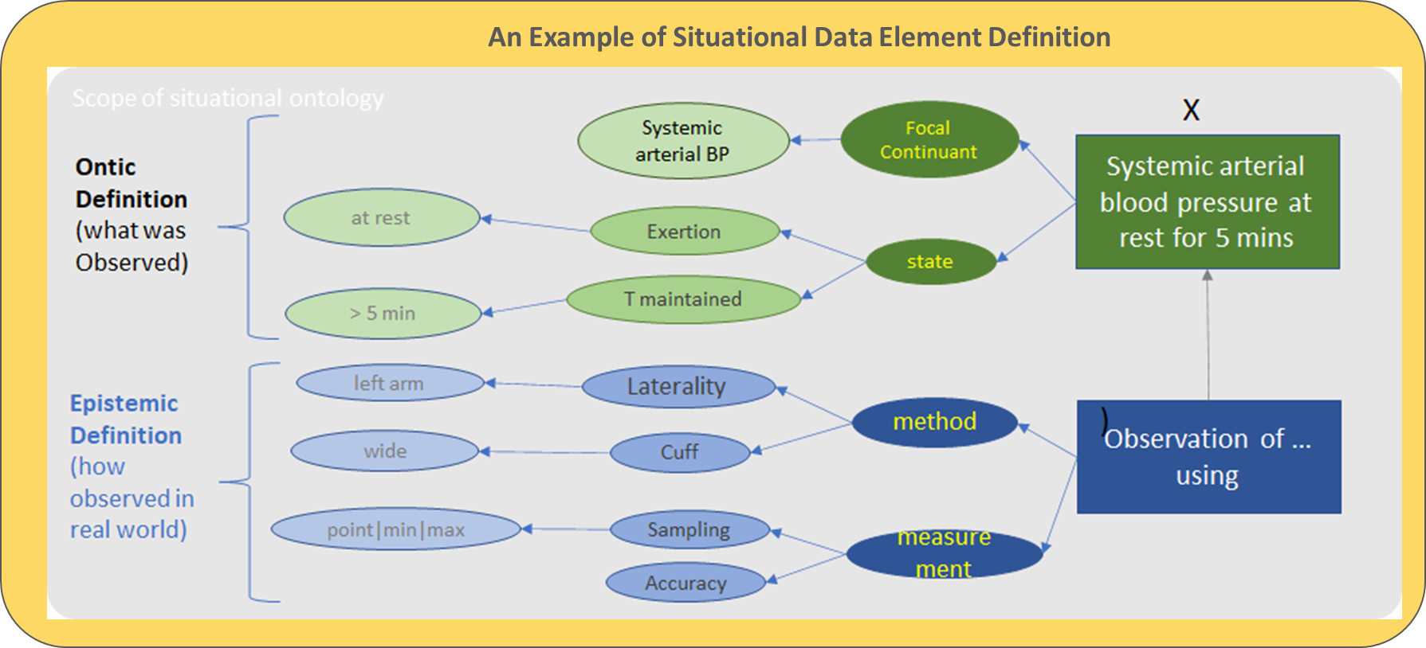
Example of a qualified concept
Foundation concept
Blood pressure: The force of circulating blood on the walls of the arteries. Blood pressure is taken using two measurements: systolic (measured when the heart beats, when blood pressure is at its highest) and diastolic (measured between heart beats, when blood pressure is at its lowest).
“BP” is
blood pressure
Qualified

Slide 10
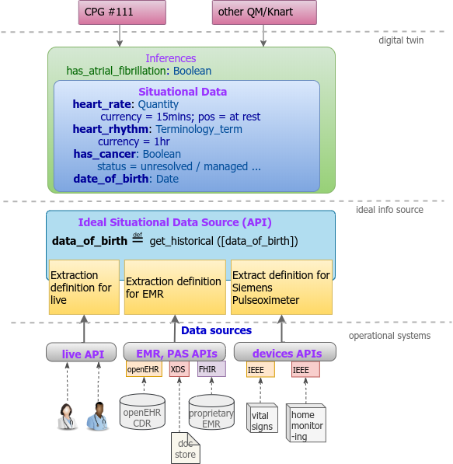
Connecting to real systems
The combination of the viewpoint “data elements”, the concepts and relationships can help automate integration using the systems and standards we already use
Clinical
Viewpoint
Guideline
Viewpoint
Concepts
HIT Viewpoint
Viewpoint
Relationships

Slide 11
Approach to solution
Define a foundational semantic model from which to derive viewpoints
Define a viewpoint model for each context, based on a viewpoint metamodel
Create a viewpoint encompassing both Ontic (about the “real world”) and Epistemic (About what we know, share and record) within a context
Connect the record to what it is about
Leverage detailed concepts in other vocabularies, code lists, and models
Provide a unifying framework without trying to model all of biology and healthcare

Slide 12
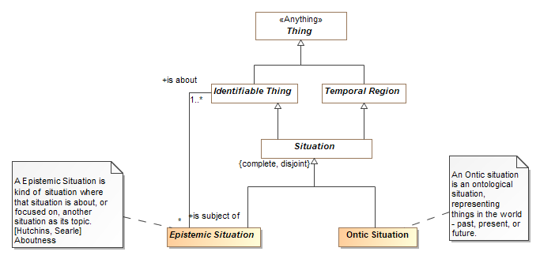
The “Ontic” / “Epistemic” Partition
We need to understand time
Viewpoint specific data
Real world concepts
Viewpoint Relationships

Slide 13
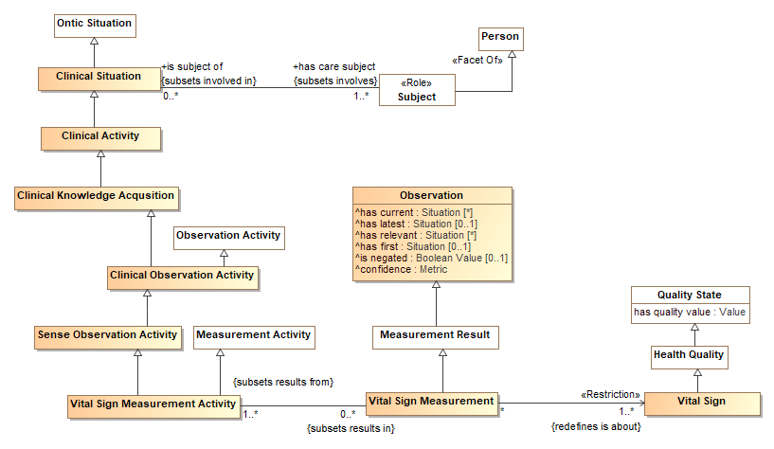
Linking to domain Concepts
Skipping down a few levels…

Slide 14
What to do?
Viewpoints provide the connectivity between multiple “Shared Data Models” , data standards, and internal representations
We have started work on both foundational semantic concepts and viewpoint representation
Defining viewpoints requires specific “meta relationships”, it is more about understanding in context rather than inferring new knowledge
The challenge – making semantic concepts understandable and relevant to a stakeholder’s context
However, it is not ready for standardization – we would like a coalition to develop and validate the approach
Then move to standardization
We invite this group to the coalition

Slide 15
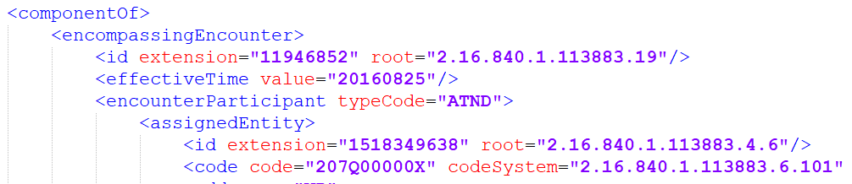
MDMI, as an integration technology, depends on consistent and unique meaning
“Simple” question: What does this mean?
MDMI Business Element

Slide 16
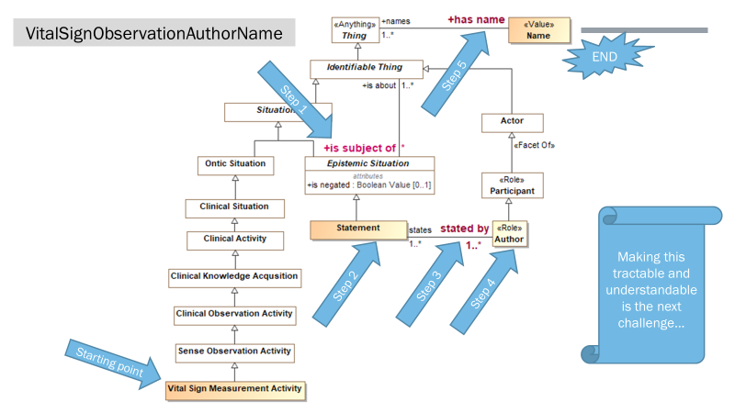
MDMI Business Elements are defined by a “path” through the model
MDMI uses the model as a reference for meaning, not to enable inference of actual data.
Given a starting point, a class in the model, a “path” through that model, including relationships and constraints, ends in a particular value
That path fully and uniquely defines a business elements meaning, it “flattens” the property in a context
In a viewpoint, a path is like an OWL property chain, but the “chain” may be constrained at each “hop” constrained based on types and restrictions

Slide 17
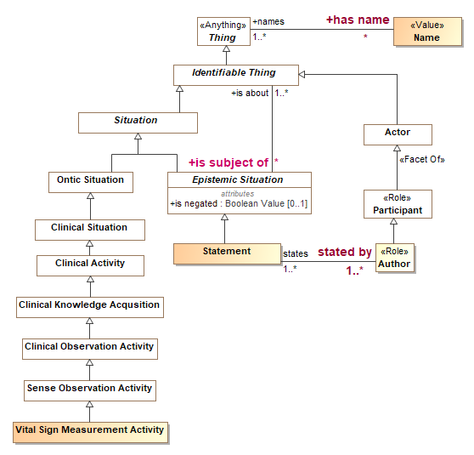
VitalSignObservationAuthorName
END
Step 5
Step 1
Making this tractable and understandable is the next challenge…
Step 2
Step 3
Step 4
Starting point

